Slide 1
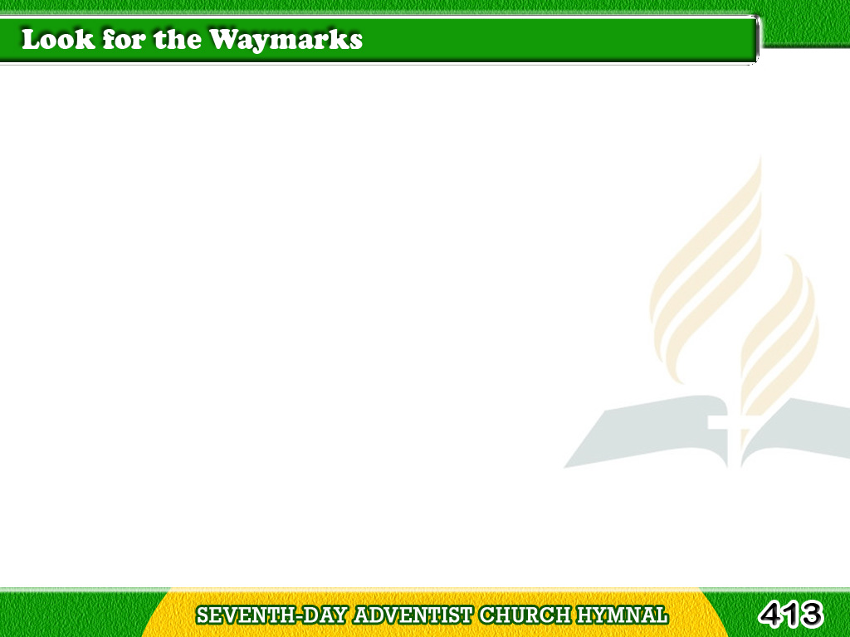
1/3
Look for the waymarks
as you journey on,
Look for the waymarks,
passing one by one;
Tagalog
Version

Slide 2
1/3
Down through the ages,
past the kingdom four
Where are we standing?
Look the waymarks o’er.
Tagalog
Version

Slide 3
1/3
Chorus
Look for the waymarks,
the great prophetic waymarks,
Down through the ages,
past the kingdoms four.
Tagalog
Version

Slide 4
1/3
Chorus
Look for the waymarks,
the great prophetic waymarks;
The journey’s almost o’er.
Tagalog
Version

Slide 5
2/3
First, the Assyrian kingdom
ruled the world,
Then MedoPersia’s
banners were unfurled;
Tagalog
Version

Slide 6
2/3
And after Greece
held universal sway,
Rome seized the scepter
Where are we today?
Tagalog
Version

Slide 7
2/3
Chorus
Look for the waymarks,
the great prophetic waymarks,
Down through the ages,
past the kingdoms four.
Tagalog
Version

Slide 8
2/3
Chorus
Look for the waymarks,
the great prophetic waymarks;
The journey’s almost o’er.
Tagalog
Version

Slide 9
3/3
Down in the feet
of iron and of clay,
Weak and divided,
soon to pass away;
Tagalog
Version

Slide 10
3/3
What will the next great,
glorious drama be?
Christ and His coming,
And eternity.
Tagalog
Version

Slide 11
3/3
Chorus
Look for the waymarks,
the great prophetic waymarks,
Down through the ages,
past the kingdoms four.
Tagalog
Version

Slide 12
3/3
Chorus
Look for the waymarks,
the great prophetic waymarks;
The journey’s almost o’er.
Tagalog
Version

